Slide 1
1
Introduction to Computers, the Internet and World Wide Web

Slide 2
The chief merit of language is clearness.
  Galen
Our life is frittered away by detail…. Simplify, simplify.
  Henry David Thoreau
He had a wonderful talent for packing thought close, and rendering it portable.
  Thomas B. Macaulay
Man is still the most extraordinary computer of all.
  John F. Kennedy

Slide 3
OBJECTIVES
In this chapter you will learn:
Basic hardware and software concepts.
Basic object-technology concepts, such as classes, objects, attributes, behaviors, encapsulation and inheritance.
The different types of programming languages.
Which programming languages are most widely used.
A typical C++ program development environment.
The history of the industry-standard object-oriented system modeling language, the UML.
The history of the Internet and the World Wide Web.
To test-drive C++ applications in two popular C++ environments—GNU C++ running on Linux and Microsoft's Visual C++® .NET running on Windows® XP.

Slide 4
1.1 Introduction
1.2 What Is a Computer?
1.3 Computer Organization
1.4 Early Operating Systems
1.5 Personal, Distributed and Client/Server Computing
1.6 The Internet and the World Wide Web
1.7 Machine Languages, Assembly Languages and High-Level Languages
1.8 History of C and C++
1.9 C++ Standard Library
1.10 History of Java
1.11 FORTRAN, COBOL, Pascal and Ada
1.12 Basic, Visual Basic, Visual C++, C# and .NET
1.13 Key Software Trend: Object Technology
1.14 Typical C++ Development Environment
1.15 Notes About C++ and C++ How to Program, 5/e
1.16 Test-Driving a C++ Application
1.17 Software Engineering Case Study: Introduction to Object Technology and the UML (Required)
1.18 Wrap-Up
1.19 Web Resources

Slide 5
1.1 Introduction
Software
  Instructions to command computer to perform actions and make decisions
Hardware
Standardized version of C++
  United States
    American National Standards Institute (ANSI)
  Worldwide
    International Organization for Standardization (ISO)
Structured programming
Object-oriented programming

Slide 6
1.2 What Is a Computer?
Computer
  Device capable of performing computations and making logical decisions
Computer programs
  Sets of instructions that control computer’s processing of data
  Written by people called computer programmers
Hardware
  Various devices comprising computer
    Keyboard, screen, mouse, disks, memory, CD-ROM, processing units, etc.

Slide 7
1.3 Computer Organization
Six logical units of computer
  Input unit
    “Receiving” section
    Obtains information from input devices
      Keyboard, mouse, microphone, scanner, networks, etc.
  Output unit
    “Shipping” section
    Places information processed by computer on output devices
      Screen, printer, networks, etc.
      Information can also be used to control other devices

Slide 8
1.3 Computer Organization (Cont.)
Six logical units of computer (Cont.)
  Memory unit
    Rapid access, relatively low capacity “warehouse” section
    Retains information from input unit
      Immediately available for processing
    Retains processed information
      Until placed on output devices
    Often called memory or primary memory
  Arithmetic and logic unit (ALU)
    “Manufacturing” section
    Performs arithmetic calculations and logic decisions

Slide 9
1.3 Computer Organization (Cont.)
Six logical units of computer (Cont.)
  Central processing unit (CPU)
    “Administrative” section
    Coordinates and supervises other sections of computer
  Secondary storage unit
    Long-term, high-capacity “warehouse” section
    Stores inactive programs or data
    Secondary storage devices
      Hard drives, CDs, DVDs
    Slower to access than primary memory
    Less expensive per unit than primary memory

Slide 10
1.4 Early Operating Systems
Early computers
  Single-user batch processing
    Only one job or task at a time
    Process data in groups (batches)
      Decks of punched cards
    Users had to wait hours or days for results
Operating systems
  Software systems that manage transitions between jobs
  Increased throughput
    Amount of work computers can process

Slide 11
1.4 Early Operating Systems (Cont.)
Multiprogramming
  Many jobs or tasks sharing computer’s resources
  “Simultaneous” operation of many jobs
Timesharing
  Special case of multiprogramming
  Users access computer through terminals
    Devices with keyboards and screens
    Dozens, even hundreds of users
  Computer use is shared among all users
    Performs small portion of one user’s job, then moves on to service next user
  Advantage
    User receives almost immediate responses to requests

Slide 12
1.5 Personal, Distributed and Client/Server Computing
Personal computers
  Popularized in 1977 by Apple Computer
    Economical enough for individual
  Ligitimized in 1981 by IBM Personal Computer
  “Standalone” units
Computer networks
  Connected over telephone lines
  Local area networks (LANs)
Distributed computing
  Organization’s computing distributed over networks

Slide 13
1.5 Personal, Distributed and Client/Server Computing (Cont.)
Workstations
  Provide enormous capabilities
Client/server computing
  File servers
    Offer common store of programs and data
  Client computers
    Access file servers across network
UNIX, Linux, Mac OS X and Microsoft’s Window-based systems support these capabilities

Slide 14
1.6 The Internet and the World Wide Web
Internet
  Global network of computers
    Initiated almost four decades ago
  Accessible by computers worldwide today
World Wide Web
  Allows computer users to locate and view multimedia-based documents
  Internet has become one of the world’s premier communication mechanisms

Slide 15
1.7 Machine Languages, Assembly Languages and High-Level Languages
Three types of computer languages
  Machine language
    Only language computer directly understands
      “Natural language” of computer
      Defined by hardware design
    Generally consist of strings of numbers
      Ultimately 0s and 1s
    Instruct computers to perform elementary operations
    Cumbersome for humans
    Example
      +1300042774
      +1400593419
      +1200274027

Slide 16
1.7 Machine Languages, Assembly Languages and High-Level Languages (Cont.)
Three types of computer languages (Cont.)
  Assembly language
    English-like abbreviations representing elementary computer operations
    Clearer to humans
    Incomprehensible to computers
      Convert to machine language by translator programs (assemblers)
    Example
      load basepay
      add overpay
      store grosspay

Slide 17
1.7 Machine Languages, Assembly Languages and High-Level Languages (Cont.)
Three types of computer languages (Cont.)
  High-level languages
    Similar to everyday English
      Uses common mathematical notations
    Single statements accomplish substantial tasks
    Converted to machine language by translator programs (compilers)
    Interpreter programs
      Directly execute high-level language programs
      Execute more slowly than the compiled program
    Example
      grossPay = basePay + overTimePay

Slide 18
1.8 History of C and C++
History of C
  Evolved from BCPL and B
    Developed by Dennis Ritchie (Bell Laboratories)
  Development language of UNIX
  Hardware independent
    Can write portable programs
  ANSI and ISO standard for C published in 1990
    ANSI/ISO 9899: 1990

Slide 19
Portability Tip 1.1
Because C is a standardized, hardware-independent, widely available language, applications written in C often can be run with little or no modification on a wide range of computer systems.

Slide 20
1.8 History of C and C++ (Cont.)
History of C++
  Extension of C
    Developed by Bjarne Stroustrup (Bell Laboratories) in early 1980s
  Provides new features to “spruce up” C
  Provides capabilities for object-oriented programming
    Objects: reusable software components
      Model items in the real world
    Object-oriented programs
      Easier to understand, correct and modify

Slide 21
1.9 C++ Standard Library
C++ programs
  Built from pieces called classes and functions
C++ Standard Library
  Rich collections of existing classes and functions
    Reusable in new applications

Slide 22
Software Engineering Observation 1.1
Use a “building-block” approach to create programs. Avoid reinventing the wheel. Use existing pieces wherever possible. Called software reuse, this practice is central to object-oriented programming.

Slide 23
Software Engineering Observation 1.2
When programming in C++, you typically will use the following building blocks: Classes and functions from the C++ Standard Library, classes and functions you and your colleagues create and classes and functions from various popular third-party libraries.

Slide 24
Performance Tip 1.1
Using C++ Standard Library functions and classes instead of writing your own versions can improve program performance, because they are written carefully to perform efficiently. This technique also shortens program development time.

Slide 25
Portability Tip 1.2
Using C++ Standard Library functions and classes instead of writing your own improves program portability, because they are included in every C++ implementation.

Slide 26
1.10 History of Java
Java
  Originally for intelligent consumer-electronic devices
    Designed by Sun Microsystems
  Then used for creating Web pages with dynamic content
  Now also used for:
    Develop large-scale enterprise applications
    Enhance World Wide Web server functionality
    Provide applications for consumer devices (cell phones, etc.)

Slide 27
1.11 FORTRAN, COBOL, Pascal and Ada
FORTRAN
  FORmula TRANslator
  Used in engineering applications
COBOL
  COmmon Business Oriented Language
  Used in business software
Pascal
  Designed to teach structured programming
Ada
  Capable of multitasking

Slide 28
1.12 Basic, Visual Basic, Visual C++, C# and .NET
BASIC
  Beginner’s All-Purpose Symbolic Instruction Code
  Familiarize novices with programming techniques
.NET platform
  Provides developers with capabilities
Visual Basic .NET
  Based on BASIC
Visual C++
  Based on C++
C#
  Based on C++ and Java

Slide 29
1.13 Key Software Trend: Object Technology
Objects
  Reusable software components that model real world items
  Meaningful software units
    Time objects, paycheck objects, record objects, etc.
    Any noun can be represented as an object
  More understandable, better organized and easier to maintain than procedural programming
  Libraries of reusable software
    MFC (Microsoft Foundation Classes)
    .NET Framework Class Library
    Rogue Wave

Slide 30
Software Engineering Observation 1.3
Extensive class libraries of reusable software components are available over the Internet and the World Wide Web. Many of these libraries are available at no charge.

Slide 31
1.14 Typical C++ Development Environment
C++ programs normally undergo six phases
  Edit
    Programmer writes program (and stores source code on disk)
  Preprocess
    Perform certain manipulations before compilation
  Compile
    Compiler translates C++ programs into machine languages
  Link
    Link object code with missing functions and data
  Load
    Transfer executable image to memory
  Execute
    Execute the program one instruction at a time

Slide 32
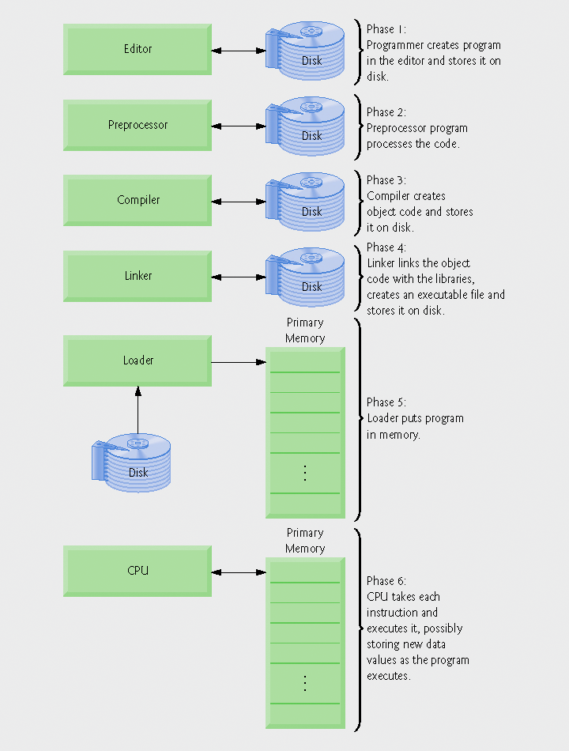
Fig. 1.1 | Typical C++ environment.

Slide 33
1.14 Typical C++ Development Environment (Cont.)
Input/output
  cin
    Standard input stream
    Normally inputs from keyboard
  cout
    Standard output stream
    Normally outputs to computer screen
  cerr
    Standard error stream
    Displays error messages

Slide 34
Common Programming Error 1.1
Errors like division by zero occur as a program runs, so they are called runtime errors or execution-time errors. Fatal runtime errors cause programs to terminate immediately without having successfully performed their jobs. Nonfatal runtime errors allow programs to run to completion, often producing incorrect results. [Note: On some systems, divide-by-zero is not a fatal error. Please see your system documentation.]

Slide 35
1.15 Notes About C++ and C++ How to Program, 5/e
This book is geared toward novice programmers
  Stresses programming clarity
Portability
  C and C++ programs can run on many different computers

Slide 36
Good Programming Practice 1.1
Write your C++ programs in a simple and straightforward manner. This is sometimes referred to as KIS (“keep it simple”). Do not “stretch” the language by trying bizarre usages.

Slide 37
Portability Tip 1.3
Although it is possible to write portable programs, there are many problems among different C and C++ compilers and different computers that can make portability difficult to achieve. Writing programs in C and C++ does not guarantee portability. The programmer often will need to deal directly with compiler and computer variations. As a group, these are sometimes called platform variations.

Slide 38
Good Programming Practice 1.2
Read the manuals for the version of C++ you are using. Refer to these manuals frequently to be sure you are aware of the rich collection of C++ features and that you are using them correctly.

Slide 39
Good Programming Practice 1.3
Your computer and compiler are good teachers. If after reading your C++ language manual, you still are not sure how a feature of C++ works, experiment using a small “test program” and see what happens. Set your compiler options for “maximum warnings.” Study each message that the compiler generates and correct the programs to eliminate the messages.

Slide 40
1.16 Test-Driving a C++ Application
Running and interacting with a C++ application
  Windows XP Command Prompt
  Linux shell

Slide 41
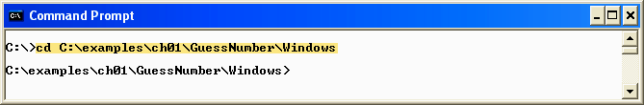
Fig. 1.2 | Opening a Command Prompt window and changing the directory.
Using the cd command to change directories
File location of the GuessNumber application

Slide 42
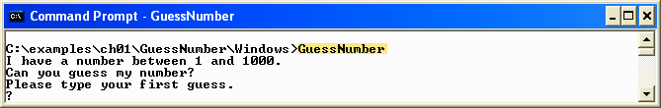
Fig. 1.3 | Running the GuessNumber application.
Enter guess number prompt

Slide 43
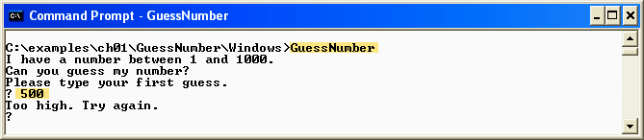
Fig. 1.4 | Entering your first guess.
Enter first guess

Slide 44
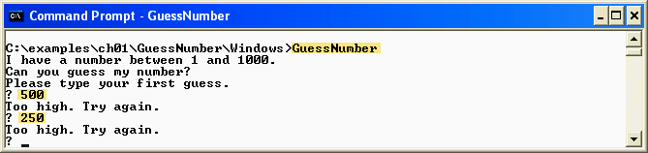
Fig. 1.5 | Entering a second guess and receiving feedback.

Slide 45
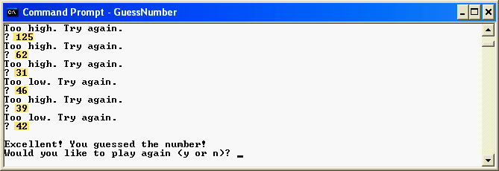
Fig. 1.6 | Entering additional guesses and guessing the correct number.

Slide 46
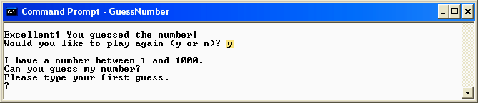
Fig. 1.7 | Playing the game again.

Slide 47
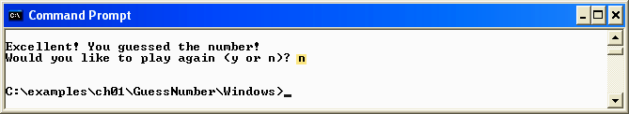
Fig. 1.8 | Exiting the game.

Slide 48
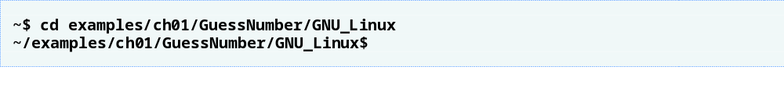
Fig. 1.9 | Changing to the GuessNumber application’s directory after logging in to your Linux account.

Slide 49
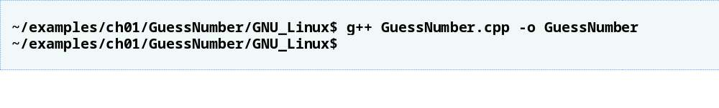
Fig. 1.10 | Compiling the GuessNumber application using the g++ command.
Compile the application with the GNU C++ compiler

Slide 50
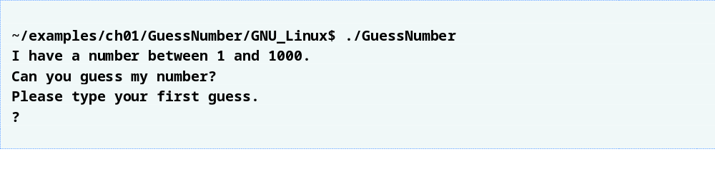
Fig. 1.11 | Running the GuessNumber application.

Slide 51
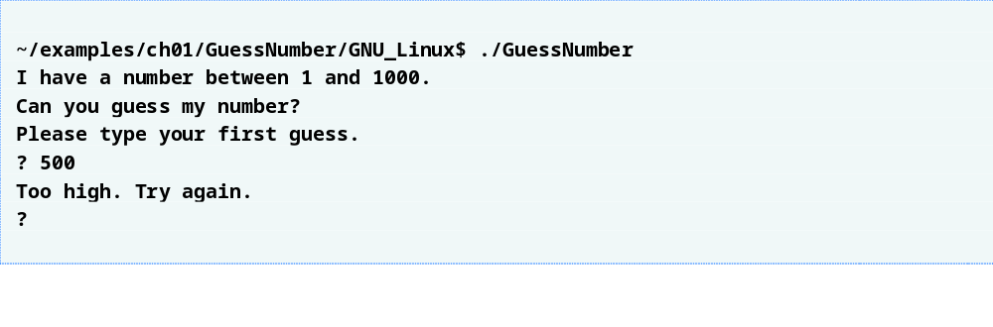
Fig. 1.12 | Entering an initial guess.

Slide 52
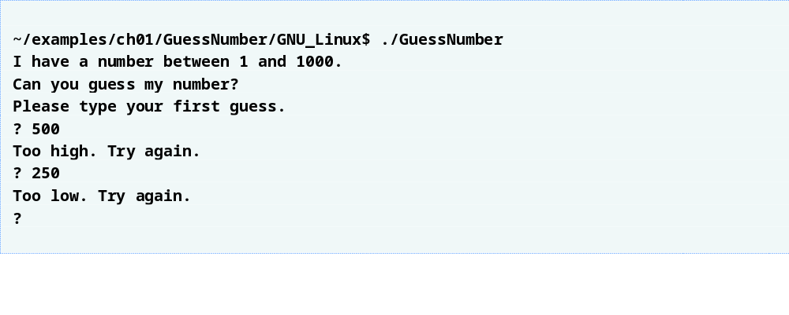
Fig. 1.13 | Entering a second guess and receiving feedback.

Slide 53
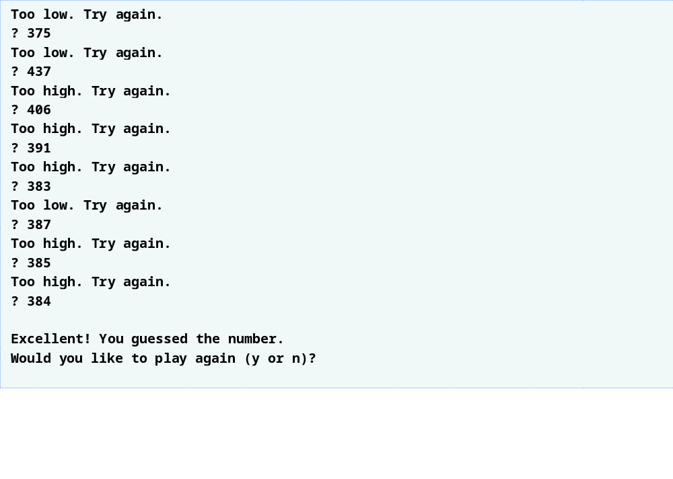
Fig. 1.14 | Entering additional guesses and guessing the correct number.

Slide 54
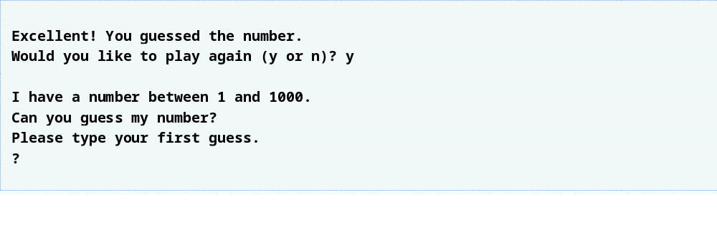
Fig. 1.15 | Playing the game again.

Slide 55
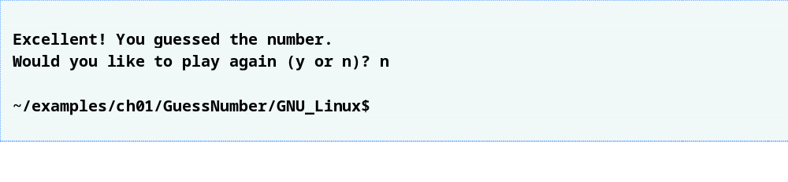
Fig. 1.16 | Exiting the game.

Slide 56
1.17 Software Engineering Case Study: Introduction to Object Technology and the UML (Required)
Object orientation
  A natural way of thinking about the world and computer programs
Unified Modeling Language (UML)
  Graphical language that uses common notation
  Allows developers to represent object-oriented designs

Slide 57
1.17 Software Engineering Case Study (Cont.)
Objects
  Reusable software components that model real-world items
  Examples are all around you
    People, animals, cars, telephones, microwave ovens, etc.
  Have attributes
    Size, shape, color, weight, etc.
  Exhibit behaviors
    Babies cry, crawl, sleep, etc.; cars accelerate, brake, turn, etc.

Slide 58
1.17 Software Engineering Case Study (Cont.)
Object-oriented design (OOD)
  Models real-world objects in software
  Models communication among objects
  Encapsulates attributes and operations (behaviors)
    Information hiding
    Communication through well-defined interfaces
Object-oriented language
  Programming in object oriented languages is called object-oriented programming (OOP)
  C++ is an object-oriented language
    Programmers can create user-defined types called classes
      Contain data members (attributes) and member functions (behaviors)

Slide 59
Software Engineering Observation 1.4
Reuse of existing classes when building new classes and programs saves time, money and effort. Reuse also helps programmers build more reliable and effective systems, because existing classes and components often have gone through extensive testing, debugging and performance tuning.

Slide 60
1.17 Software Engineering Case Study (Cont.)
Object-Oriented Analysis and Design (OOAD)
  Analyze program requirements, then develop solution
  Essential for large programs
  Plan in pseudocode or UML

Slide 61
1.17 Software Engineering Case Study (Cont.)
History of the UML
  Used to approach OOAD
  Object Management Group (OMG) supervised
    Brainchild of Booch, Rumbaugh and Jacobson
  Version 1.5 is current version
    Version 2 under development
UML
  Graphical representation scheme
  Enables developers to model object-oriented systems
  Flexible and extendible

